Slide 2
IEEE Standard
IEEE 802 specifies to a group of IEEE standards. IEEE standards 802 are used for controlling the Local Area Network and Metropolitan Area Network. The user layer in IEEE 802 is serviced by the two layers- the data link layer and the physical layer.

Slide 3
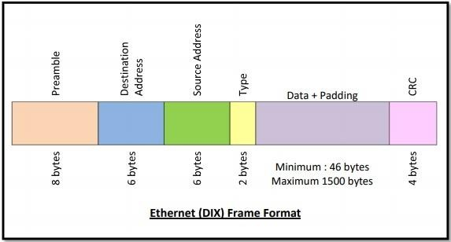
Frame Format of Classic Ethernet IEEE 802.3

Slide 4
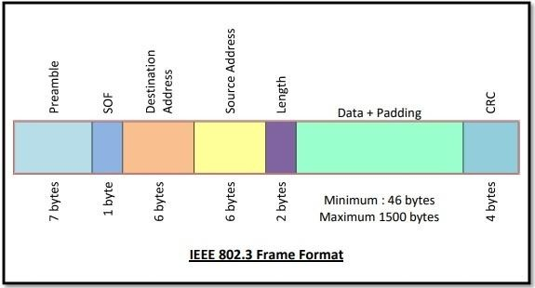
Frame Format of Classic Ethernet IEEE 802.3

Slide 5
Frame Format of Classic Ethernet 802.3
Classic Ethernet frames can be either of Ethernet (DIX) or of IEEE 802.3 standard. The frames of the two standards are very similar except for one field. The main fields of a frame of classic Ethernet are −
Preamble − It is the starting field that provides alert and timing pulse for transmission. In case of Ethernet (DIX) it is an 8
byte field and in case of IEEE 802.3 it is of 7 bytes.
Start of Frame Delimiter (SOF) − It is a 1 byte field in an IEEE 802.3 frame that contains an alternating pattern of ones and zeros ending with two ones. 11000011 -----11000011
Destination Address − It is a 6 byte field containing physical address of destination stations.

Slide 6
Continued..
Source Address − It is a 6 byte field containing the physical address of the sending station.
Type/Length − This is a 2 byte field. In case of Ethernet (DIX), the field is type that instructs the receiver which process to give the frame to. In case of IEEE 802.3, the field is length that stores the number of bytes in the data field.
Data − This is a variable sized field carries the data from the upper layers. The maximum size of data field is 1500 bytes.
Padding − This is added to the data to bring its length to the minimum requirement of 46 bytes.
CRC − CRC stands for cyclic redundancy check. It contains the error detection information.

Slide 7
The generally uses specifications of IEEE 802 are:
IEEE 802.3
The IEEE 802.3 standard determines the CSMA/CD access control protocol. The best known scheme for controlling a local area network on a bus structure is carrier sense multiple action with collision detection(CSMA/CD).
IEEE 802.4
IEEE 802.4 describes a token bus LAN standards. In token passing methods, stations connected on a bus are arranged in a logical ring. In this method only the station having token(token holder)is being permitted to transmit frames.
IEEE 802.5
IEEE 802.5 describes the token ring standards. In a token ring a special bit pattern, called the token, circulates around the ring whenever all stations are idle. The sequence of token is determined by the physical locations of the stations on the ring.

Slide 8
Difference between IEEE 802.3, 802.4 and 802.5
S. No. | IEEE 802.3 | IEEE 802.4 | IEEE 802.5
1. | Topology used in IEEE 802.3 is Bus Topology. | Topology used in IEEE 802.4 is Bus or Tree Topology. | Topology used in IEEE 802.5 is Ring Topology.
2. | Size of the frame format in IEEE 802.3 standard is 1572 bytes. | Size of the frame format in IEEE 802.4 standard is 8202 bytes. | Frame format in IEEE 802.5 standard is of the variable size.
3. | There is no priority given in this standard. | It supports priorities to stations. | In IEEE 802.5 priorities are possible
4. | Size of the data field is 0 to 1500 bytes. | Size of the data field is 0 to 8182 bytes. | No limit is of the size of the data field.
5. | Minimum frame required is 64 bytes. | It can handle short minimum frames. | It supports both short and large frames.
6. | Efficiency decreases when speed increases and throughput is affected by the collision. | Throughput & efficiency at very high loads are outstanding. | Throughput & efficiency at very high loads are outstanding.
7. | Modems are not required. | Modems are required in this standard. | Like IEEE 802.4, modems are also required in it.
8. | Protocol is very simple. | Protocol is extremely complex. | Protocol is moderately complex.

